Slide 1
PERFORMANCE TEST ON SINGLE CYLINDER CI-ENGINE WASTE PLASTIC FUEL BLEND WITH DIESEL FUEL
Under the guidence of :VENKATESHWARLU SIR
Presented by: Rajesshwari 1602-15-736-096
Manvitha 1602-15-736-081
Pranay 1602-15-736-093

Slide 2
ABSTRACT
As the fossil fuels are depleting at a very faster rate, there is a need to find out an alternative fuel to fulfill the energy demand of the world. Plastic fuel is one of the best available sources to fulfill the energy demand of the world. The petroleum fuels play a very significant role in the development of industrial growth, transportation, agricultural sector and to meet many other basic human requirements. However, these fuels are limited and depleting day by day as the consumption is increasing very rapidly. Moreover, their use is alarming the environmental problems to society. Hence, there is a need of research for alternative fuels. There is a long list of syringe water bottle etc. waste plastic chair available abundantly in India, which can be exploited for the production of plastic fuel. Recent research on plastic fuel focused on performance of plastic fuel and its blends with diesel. The present work aims to investigate the possibilities of the application of mixtures of two plastic fuel and its blends with diesel as a fuel for diesel engines. The present investigations are planned after a thorough review of literature in this area. The combinations of plastic fuel, along with diesel are taken for the experimental analysis. There was no evidence of any practical multi-blend plastic fuel source engine. Experiments are conducted using a single cylinder direct-injection diesel engine with different loads at rated 1500 rpm. The brake thermal efficiency of PF-10 has maximum 18.1% compares to pure diesel 18.71% at 1.5 kW brake power. Maximum specific fuel consumption is obtained in PF-30 (0.715) compare to pure diesel at 0.5 kW brake power. The results which obtained are significantly comparable to pure diesel. The multi-blend plastic fuel is suitable alternative fuel for diesel in stationary/agricultural diesel engines.

Slide 3
Content
Introduction
Methods to produce fuel
Results
Conclusions

Slide 4
What is plastic ?
The term “plastics” includes materials composed of various elements such as carbon,hydrogen,oxygen,nitrogen,chlorine and sulphur.
It is one of the few new chemical materials which pose environmental problem.
Polethylene, polyvinyl chloride, polystyrene is largely used in the manufacturing of plastics.

Slide 5
Why do we need to convert waste plastic into fuel ?
According to recent study performed by the Environmental Protection Agency approximately billion of tons of waste plastic are generated in the world.
Statistics show that approximately 10% of this plastic is recycled, 25% is incinerated and remaining 65% is dumped in landfills.
Converting the waste plastic into valuable energy resource to fully utilize the waste in order to meet the increased energy demand.

Slide 6
METHODS TO CONVERT PLASTIC INTO FUEL
Pyrolysis Breakdown: It is generally defined as the controlled burning or overheating of a material in the absence of oxygen.
1.Thermal pyrolysis.
2. Catalytic pyrolysis.

Slide 7
1.Thermal pyrolysis
The thermal pyrolysis proceeds according to the radical chain reactions with hydrogen transfer steps and the gradual breakdown of the main chain.
Products obtained are hydrocarbons composed of c5-c80 range.

Slide 8
2. Catalytic pyrolysis
Decomposition reactions at low temperatures with lower energy consumption.
Increase the process selectivity.
Catalysts used are AlCl3,TiCl4,FeCl3 and TiCl3.

Slide 9
ESTIMATED PROPERTIES OF MULTI-BLEND PLASTIC FUEL WITH DIESEL FUEL
properties | Diesel | PF-10 | PF-20 | PF-30
Fuel density Kg/m^3 | 830 | 835 | 840 | 850
Kinematic viscosity at 40deg | 3.0 | 3.3 | 3.5 | 3.8
Flash point in deg Celcius | 50 | 54 | 58 | 64
Fire point in deg C | 57 | 64 | 68 | 74
Calorific value kj/kg | 42,680 | 42,461 | 42,243 | 41,807

Slide 10
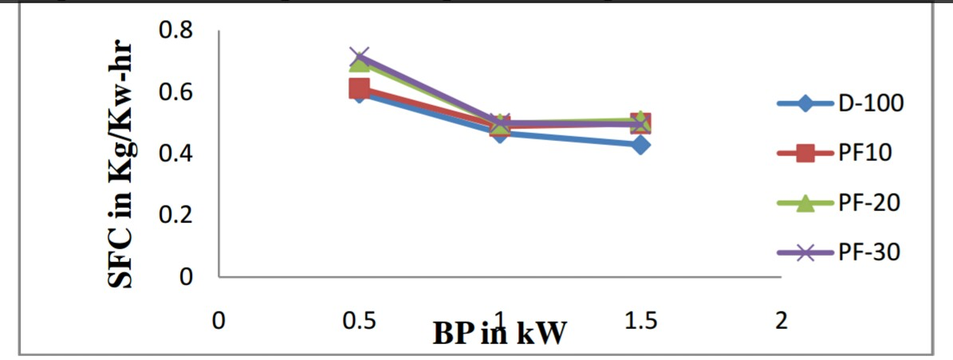
Variation of specific fuel consumption with respect to brake power

Slide 11
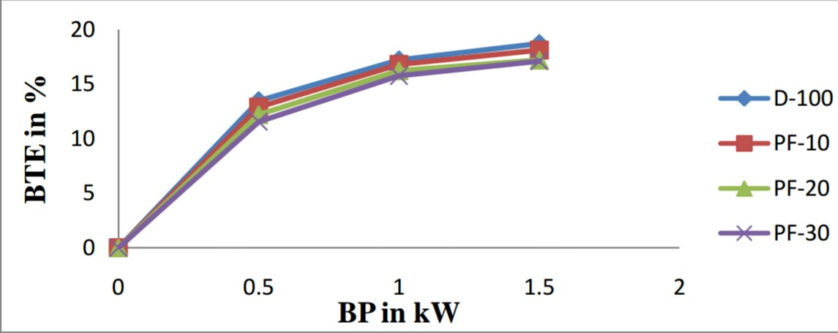
2.Variation of brake thermal efficiency with respect to brake power

Slide 12
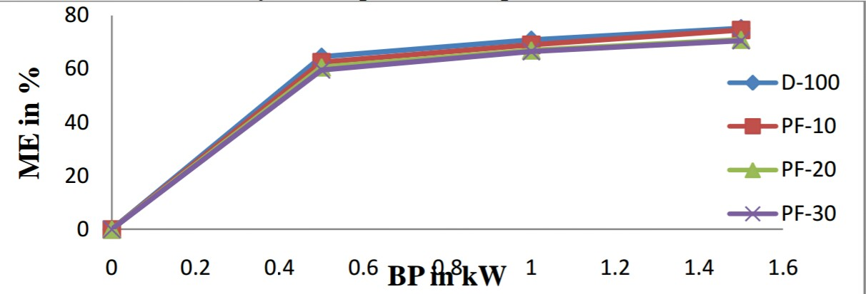
3.Variation of mechanical efficiency with respect to brake power

Slide 13
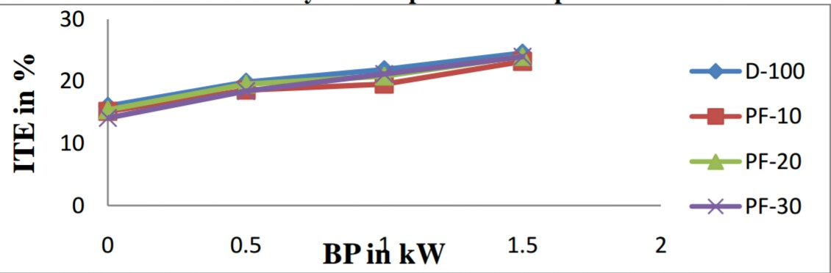
4.Variation of indicated thermal efficiency with respect to brake power

Slide 14
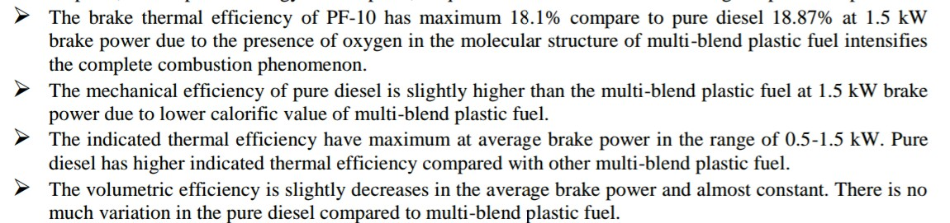
Conclusions:

Slide 15
References:
.
1. Gupta S, Mohan K, Prasad R, Gupta S, Kansal A [et al.]. Solid waste management in India: options and opportunities.Resources Conservation and Recycling 1998.
2 . Ladommatos N, Balian R, Horrocks R, Cooper L [et al.]. The effect of exhaust gas recirculation on combustion and NOx,emissions in a high speed DI diesel engine. SocAutomotEng Trans 1996.
3. M.Mani,G.Nagarajan,S.Sampath[etal.].An experimental investigation on a DI diesel engine using waste plastic oil with exhaust gas recirculation.2010.
4. M.Mani,G.Nagarajan,S.Sampath[et al.].Characterizations and effect of using waste plastic oil and diesel fuel blends in compression ignition engine.
5. M. Mani a,C. Subash b, G. Nagarajan[et al.]. Performance, emission and combustion characteristics of a DI diesel engine using waste plastic oil.2010.

Slide 16
THANK YOU

